Slide 1
Social Stories
An evidence-based strategy for working with children with autism.

Slide 2
What is a Social Story?
A social story:
is a short story
is an evidence-based strategy
can be used across all environments
teaches or maintains appropriate behaviours and responses for social skills, daily living skills or behaviour management skills.
addresses specific situations

Slide 3
What is the Purpose of a Social Story?
To describe social situations and appropriate responses
To help student understand specific situations
To correct student responses to a social situation in a non-threatening manner
To personalise instruction for each student
To break goals into easy steps
To teach routines for better retention and generalisation
To help the student cope with both expected and unexpected transitions
To address a wide variety of problem behaviours (i.e., aggression, fear, obsessions)

Slide 4
How to Get Started
1. Identify the target behaviour to change or maintain. Focus on writing the social story about the behaviour you want the individual to learn or increase.
Example – When Johnny wants a toy that another child is playing with; he simply goes over and takes it.
Behaviour to increase: sharing, asking, finding another toy, etc.

Slide 5
How to Get Started
2. Define the target behaviour, gather information and collect data.
Teachers, parents, and others involved need to have an identical understanding the behaviour being targeted. Specific, descriptive and measurable information must be noted.
Example - Measure Johnny’s toy-grabbing behaviour. Record a tally mark on a chart each time Johnny grabs a toy from a peer. Measure during an hour, session, or day. This type of data collection can last for 3 days or longer until sufficient information has been gathered.

Slide 6
How to Get Started
Observe situations that often present problem behaviours.
Recognise the student’s perspective of the specific situation. Ask the student, if possible.
Interview teachers, parents and others involved concerning the student’s behaviour (see example questions).
Gather information about the child’s interests, abilities, impairments, and motivating factors.
Determine the topics for the social story.

Slide 7
How to Get Started –Questions to determine target behaviour
Does the behaviour occur following a request to perform a difficult task?
Does the behaviour occur when the student wants to get a toy, food, or activity that he/she has been told he/she cannot have?
Does the child enjoy performing the behaviour? (E.g.,it feels, tastes, looks, smells, and/or sounds pleasing.)
When the behaviour occurs, does the child seem calm and unaware of anything else going on around him?
Does the behaviour occur whenever you stop attending to the child?
Would the behaviour occur repeatedly for long periods of time if no one were around? (E.g., rocking back and forth for over an hour.)

Slide 8
How to Get Started
3. Tailor the text
Individualise the story for the student
Use language appropriate for the student. Consider student’s comprehension and vocabulary.
Write from the student’s perspective
Write in first person. “I can…”
Answer ‘wh’ questions, be concrete and be literally accurate. If flexibility is needed, use ‘sometimes’ or ‘usually’
Use positive language

Slide 9
How to Get Started
Use the four types of sentences:
1. Descriptive – tells where situations occur, who is involved, what they are doing, and why. What is going to happen? Example: "At recess, there are many children playing with the ball."
2. Perspective – describes the reactions and feelings of the student and of other people. How do I or others feel? Example: "When I take the ball without asking, it makes the other children angry."
3. Directive – tells student what to do. What should I do? Example: "When I want to play with the ball, I will ask the other children first."
4. Affirmative – emphasizes an important aspect, the rule or reassures the student. Example: “This is a friendly thing to do.”

Slide 10
How to Put a Social Story Into Practice
Read the story to the child in a location with few distractions.
Briefly explain the importance of a social story.
For example, discuss with Johnny the importance of sharing – making friends, getting along.
Read through the story once or twice and, when necessary, model the desired behaviour.
For example, after reading with Johnny his social story on sharing, the adult plays with one of Johnny’s favourite toys. Johnny is encouraged to ask for the toy and respond appropriately.
If appropriate, create a schedule for the child in which the story is read at the same time and in the same way each time.
Read the story just prior to a situation in which the problem behaviour is likely to occur, if appropriate.
For example, if Johnny’s problem with toy grabbing occurs mainly at recess, it may be helpful to read the social story right before recess each day.
Consider providing opportunities for the student to read the social story with other children or adults.

Slide 11
How to Determine if the Social Story is Successful
Observe the student’s behaviour and comments when the story is presented.
Conduct ongoing data collection on the child’s behaviour (Has the child acquired, generalised, and maintained the new behaviour?).
Compare your observations to those of teachers, parents, and others.
Collect data now that the story has been implemented and compare the data to the previous data.

Slide 12
What if the Social Story is not Successful?
If the student has not responded to the social story after an appropriate length of time (note: this varies by target behaviour and the time each child requires to learn a new skill), review the social story and how it has been used. If modifications are needed, change only one aspect of the social story at a time.
For example, change when the story is read. Do not change the words of the story or who reads the story. This helps determine what aspect of the social story works and does not work with the child.
If Johnny’s social story is read to him before recess, he may become too excited and be unable to listen to the story. Therefore, maybe the story should be read at a different time during the day.

Slide 13
What to Do Next
Fade the social story - extend the time between readings or having the student read the story independently.
Work with the student or parents to identify new skills to address.
Create new social stories that address other targeted behaviours.
Help the student continue to generalise new behaviours.
For example, the teacher could help Johnny generalise toy grabbing in situations outside of the classroom, such as recess, PE, and music.
Reintroduce the previous story, as needed.
For example, Johnny stopped grabbing toys away from others for approximately one month. However, the story was reintroduced when the behaviour began to reoccur.

Slide 14
Summary
A social story helps students with ASD acquire, generalise, and maintain social skills that make them more successful at school, home and the community.
The first step in writing a social story is to identify the target behaviour.
Write the social story taking care that the vocabulary matches the student's reading/functioning level. If possible, write the story with the student.
Format the story to match the learner's age and functioning level.
For example, when writing a social story for an early primary-age student, consider limiting the number of sentences to 1 to 3 per page and use a book-like format. If writing a social story for a high school student who has average to above-average cognitive abilities, consider constructing the story on an A4 piece paper using single- or double-space format that resembles an essay.

Slide 15
Summary
Include any combination of descriptive, perspective, directive, or affirmative sentences.
If needed, use pictures, photographs, or symbols to assist comprehension.
Construct the social story out of materials appropriate for the child’s developmental level using cardboard, poster board, laminated pages, etc.
Provide an appropriate routine for the social story to be read.
If the student does not appear to be responding to the social story, adjust the content of the story and/or the student's access to the social story.
Fade the social story when the desired outcome is maintained and reintroduce if needed. Remember that some students may continue to rely on a social story for an extended period of time

Slide 16
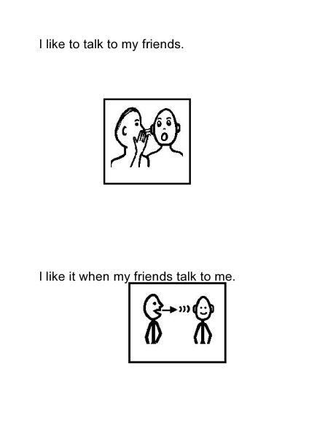
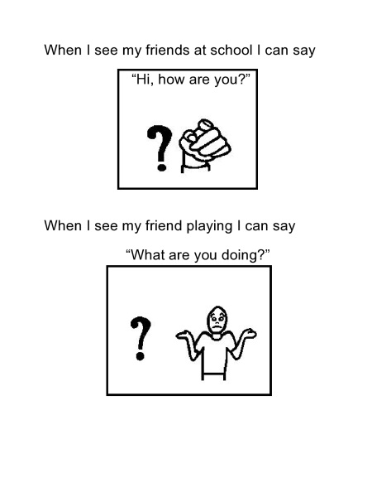
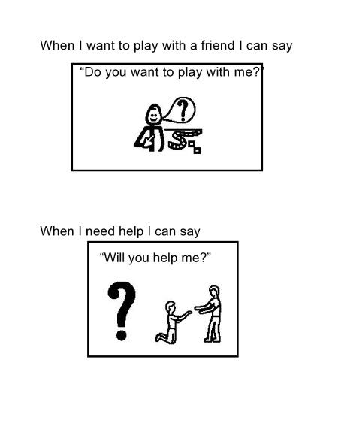
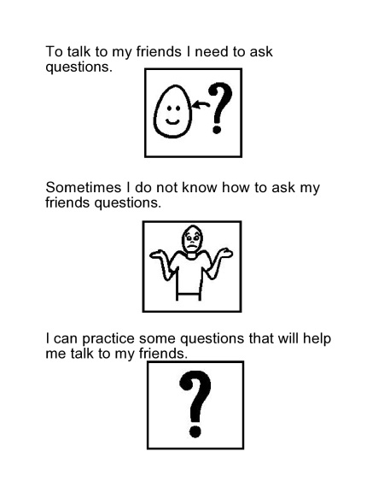
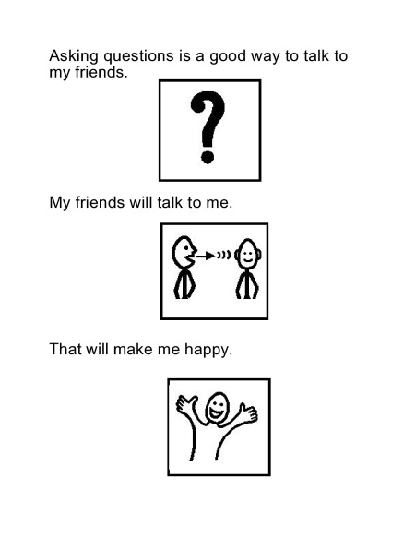
Sample Social Stories
From: http://region2library.org/DATA/Social%20Stories/Asking_questions.pdf

Slide 17
Sample Social Stories
People I Can Talk To
Sometimes I go shopping with Dad and Mum and we buy groceries and meat and clothes.
Sometimes Dad and Mum buy me chips.
I talk to Dad when I am shopping. I talk to Mum when I am shopping.
Sometimes I give money to the shop lady.
I can say “hello” to the shop lady. I can say “thank you” to the shop lady.
I only talk to people I know at the shops.
I like to talk to Mum and Dad.
I am pleased I am learning who I can talk to.
From: http://www.cheri.com.au/documents/Whataresocialstories.pdf

Slide 18
Sample Social Stories
Who is Line Leader?
My name is Andrew. I am in the first grade. Sometimes, the children in my class form one line.
The children in my class stand in a line when we are getting ready to go to another part of the school. Children do move a little when they stand in a line. Children may move to scratch, or fix their shirt, or their shoe. Sometimes, because they are standing close together, children may touch one another. Many times, it is an accident when children touch one another in line. They were not planning to touch another child.
The children in my class walk in a line to move safely in the halls. Walking in a line keeps children in order, too. If another group of students are walking in the hall going the opposite direction, the two groups can pass one another easily. That's why teachers have asked children to walk in lines for many, many years. It is a safe and organized way to move many children.
Usually, children stand and walk in lines for a short period of time. Once the children reach their destination, their teacher often doesn't need them to stay in the line anymore.
Sometimes, I may be the Line Leader. This means that the other children in my class will walk behind me.
Sometimes, I may be second, or third, or fourth, or another position.
Many children in my class like to be the Line Leader. My teacher knows who should be first in line. Teachers know about being fair, and try to make sure each child is Line Leader now and then.
It's important to follow directions about who is Line Leader. My turn to be Line Leader again gets closer every time the children in my class walk in a line
From: http://www.thegraycenter.org/social-stories/what-are-social-stories

Slide 19
References and Good Websites
http://www.thegraycenter.org/social-stories
http://www.cheri.com.au/documents/Whataresocialstories.pdf
http://www.oneplaceforspecialneeds.com
http://www.ccsd.edu/LittleTor.cfm?subpage=5804
http://www.boardmakershare.com/
http://kidstherapyassociates.blogspot.com.au/
http://www.region2library.org/socialstories.htm
http://www.setbc.org/pictureset/Default.aspx
http://kidscandream.webs.com/page12.htm
The New Social Story Book by Carol Gray

